Slide 1

Exploring Survival on the Titanic
Andrea Fox
DSC550-T301
Term Project
Notes:
As some of you may know I did my undergrad in History, so exploring the survival rate of the Titanic seemed like a natural thing for me to cover.
I also told the story of the Titanic to my 10 year old daughter a few years ago, which she loves when I tell stories from history
Even now when we go for our walks, we have discussed things that could have been done differently, why did so many people die, who survived, etc.

Slide 2
Table of Contents
Introduction – Description and Questions
Variables
Loading in the data
Overview of cleaning
Visualizations
Algorithms
Notes:
Here is the Agenda or Topics I plan to cover during this presentation.
We’re going to start with the Description of my project and what questions I was hoping to answer
Go through the different variables
Overview of how and what I did with the data during the cleaning process
Look at some of the visualizations
What algorithm I selected and what I found

Slide 3
Topic
I decided to do my project on Titanic survival as my daughter and I love discussing the story of what happened to the Titanic. We have spent many hours going through where things went wrong as well as the possibility of a different outcome if they had hit the iceberg head on instead of trying to turn away from it. She also enjoys coding so I may have her do some of this with me as a fun activity.

Slide 4
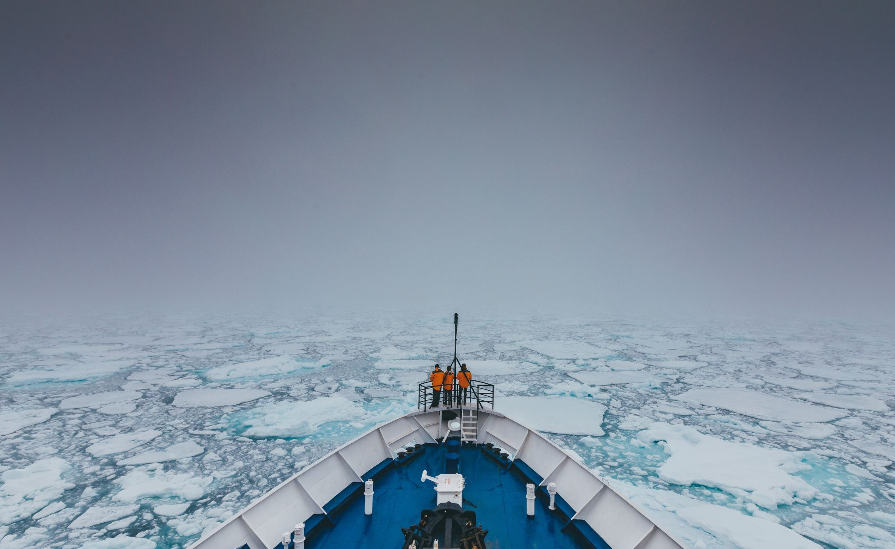
Questions
Did female passengers have a higher rate of survival then males? (I have heard and read that women and children were evacuated first but I want to form my opinion that is data driven)
Did the type of class fare play a role into survival rates?
Were families more likely to survive than a single passenger?
Did age of passenger play a role in survival?

Slide 5
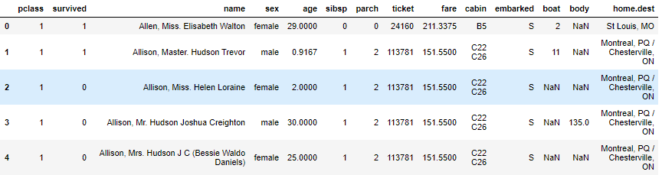
Variables
Pclass = Passenger Class
Survived = (0 = No, 1 = Yes)
Name = Name of passenger
Sex = Sex of passenger
Age = Passenger age
Sibsp = Number of siblings/spouses aboard
Parch = Parents/children aboard
Ticket = Ticket Number
Fare = Cost of fare
Cabin = Cabin aboard ship
Embarked = (S = Southampton, C = Cherbourg, Q = Queenstown)
Boat = Lifeboat
Body = Body Number
Home.dest = Home destination

Slide 6
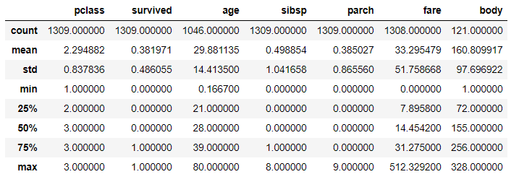
Data Description
Found the mean survival rate was 38%
Maximum age 80 and minimum age 0 (baby)
Average age was 30
Average ticket class was 2nd class
Notes:
Did data.describe() to get this information
Some facts

Slide 7
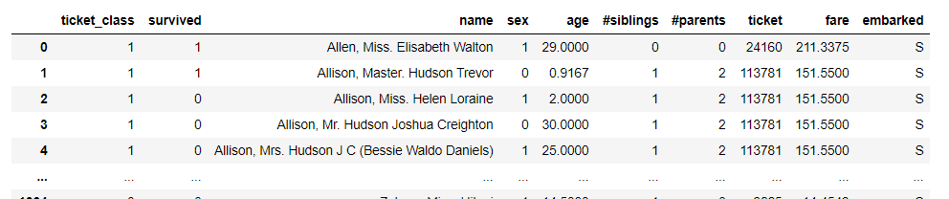
Overview of Cleaning Data Process
Changed some of the variable/column names
Changed values in ‘Sex’ column to be numeric
Checked for null values
Dropped boat, body, cabin, and home destination as they had the most null values and weren’t needed to answer questions
Notes:
Changed variable column names to make more sense or be easier to work with
Changed sex to numeric where 0 = male and 1 = female
Created relatives that encompassed parents and siblings. Also created not alone column where 1 meant they were not travelling with anyone, and 0 meant they were travelling with either siblings, parents, or children
For age I looked at mean and standard deviation. Then computed random numbers between the mean, std, and placed into the null values

Slide 8
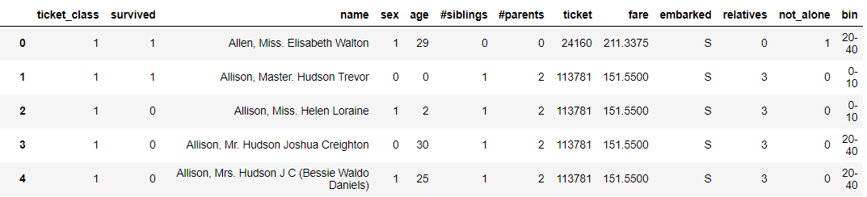
Overview of Cleaning Data Process
Created 2 columns for relatives and then figured not alone based off of relatives.
Filled in age values as there were a lot of null values, and this column was necessary to answer questions
Created another new column called bins to look at age groups: 0-10, 10-20, 20-40, 40-60, and 60-100
Tried to do just 60+ but it wouldn’t evaluate correctly without and ending number
Notes:
Changed variable column names to make more sense or be easier to work with
Changed sex to numeric where 0 = male and 1 = female
Created relatives that encompassed parents and siblings. Also created not alone column where 1 meant they were not travelling with anyone, and 0 meant they were travelling with either siblings, parents, or children
For age I looked at mean and standard deviation. Then computed random numbers between the mean, std, and placed into the null values

Slide 9
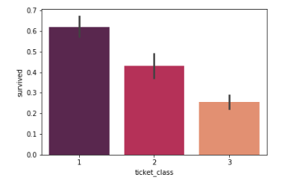
Survival rate based on ticket class
Notes:
First visualization I did was survival rate based off of ticket class. I had the assumption that more first class would survive over the others especially 3rd class.

Slide 10
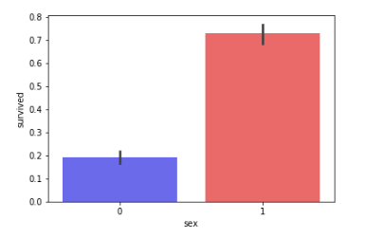
Survival rate based on Sex
Notes:
Male = 0
Female = 1

Slide 11
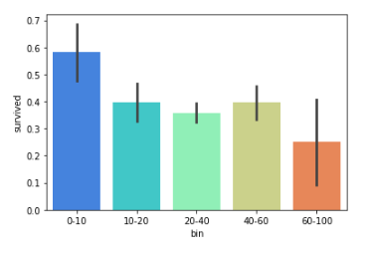
Survival rate based on Age Bin
Notes:
Again here I had the assumption that more children would survive based off of historical accounts

Slide 12
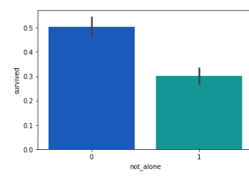
Survival rate based on Traveling alone
Notes:
Group 0 = traveled with others
Group 1 = traveled alone

Slide 13
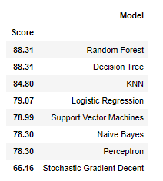
Finding Best Algorithm
Tried the following types:
Stochastic Gradient Descent
Random Forest
Logistic Regression
K Nearest Neighbor
Gaussian Naïve Bayes
Perceptron
Linear Support Vector Machine
Decision Tree
Found that Random Forest or Decision Tree were the best fits.
Notes:
Found a way to look at each algorithm type and see what would work best for my data. I found that Random Forest and Decision Tree was the best fit (they are also very similar in nature), while Stochastic Gradient Descent did not fit well at all.
Random Forest is a supervised learning algorithm. It creates a forest that is somehow random, which is an ensemble of decision trees
Basically it is multiple decision trees that are merged together to get a more accurate prediction

Slide 14
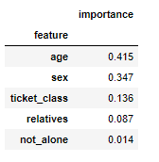
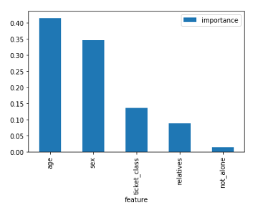
Feature Importance
Importance Score
Importance Plot
Notes:
Feature importance is a qualify of random forest that makes it easy to measure the relative importance of each feature. Here we can see age was ranked the highest while not_alone scored very low.
This means not_alone and relatives do not play a significant role in the random forest process. So I decided to remove them
X_train subset was made up of these features
Y_train subset was made up of survival

Slide 15
Random Forest
OOB Score = 79.53%
Precision = 41%
Recall = 41%
F1 Score = 41%
ROC – AUC Score = 93%
Notes:
I checked the following score:
OOB or out of bag score. This estimates the general accuracy
My precision, recall, and F1 score did not look very good so I did start to wonder about my model and whether I either did it right or if my model was incorrect. I was using a reference that used the Kaggle datasets (which I didn’t) and also had a x_test subset that I did not use.
Prediction = 41% of the time a passengers survival correctly
Recall = 41% it predicted the survival of 41% of the people who actually survived
F1 Score is combination of prediction and recall, which means it will only be high if both prediction and recall are
ROC – AUC score is a performance measurement. ROC is the probability and AUC represents degree of measure of separability. The higher the AUC the better prediction

Slide 16
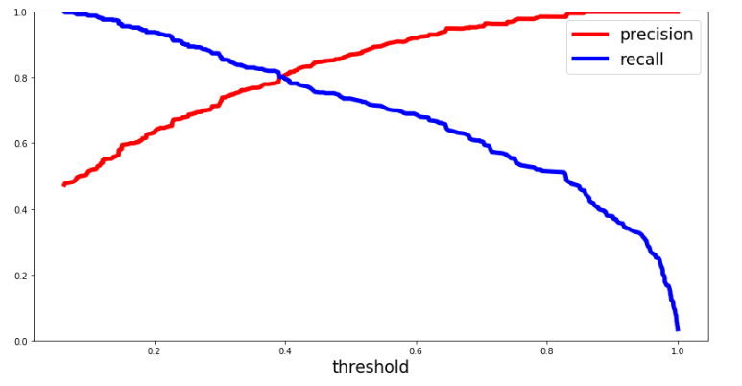
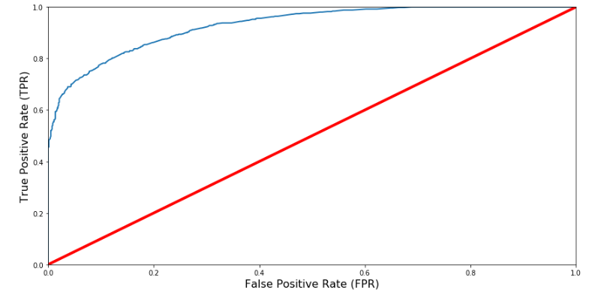
Additional plots from scores
Precision & Recall with Threshold
ROC – AUC Curve
Notes:
I plotted both precision and recall and ROC – AUC curve.
Recall makes a sharp turn down at 40ish% as shown in previous slide.
The red line in ROC – AUC represents random rate and blue line is my prediction rate. Looking at it initially it looks good but I also found out that the higher the true positive rate the higher the false positive rate.

Slide 17
References
Harrell, F. (2020, February 26). DataSets ‹ Main ‹ Vanderbilt Biostatistics Wiki. Vanderbilt Biostatistics Wiki. Retrieved July 26, 2020, from http://biostat.mc.vanderbilt.edu/wiki/Main/DataSets
Karbowiak, E., & Biecek, P. (n.d.). Passengers And Crew On The RMS Titanic — Titanic_data EIX. Model Oriented. Retrieved July 26, 2020, from https://modeloriented.github.io/EIX/reference/titanic_data.html
Donges, N. (2018, May 14). Predicting The Survival Of Titanic Passengers. Medium. Retrieved July 26, 2020, from https://towardsdatascience.com/predicting-the-survival-of-titanic-passengers-30870ccc7e8
Narkhede, S. (2018, June 26). Understanding AUC - ROC Curve. Medium. Retrieved July 26, 2020, from https://towardsdatascience.com/understanding-auc-roc-curve-68b2303cc9c5#:~:text=AUC%20%2D%20ROC%20curve%20is%20a,degree%20or%20measure%20of%20separability.&text=By%20analogy%2C%20Higher%20the%20AUC,with%20disease%20and%20no%20disease.

